Slide 1
ACME (Or, “Taking over the World”)
Introduction
Notes:
Instructor:
Read through the whole lesson (including all the notes) before the day of class
Make note of and gather any supplies you need to bring
Prepare examples, stories
Think through how much time you want to spend on individual activities; make notes
Be sure to allow time to announce the assignment at the end
Overview:
Intro (slides 1-5): 4-6 minutes
ACME: 40-45 minutes
Wrap-up: 1-2 minutes
Total: 45-53 minutes

Slide 2

Introductions
Take a moment and introduce yourself:
Name?
Where did you grow up?
One interesting fact about you?
Notes:
Image from commons.wikimedia.org

Slide 3
Class format
Students will take turns teaching this class using these materials for this course
Grading
In-class participation
Out-of-class application assignments
Teaching
This class is meant to be practical and enjoyable, not a royal drag or a burden
Notes:
Grading
In-class participation (students will self-report their participation level two times during the semester; mid-term, and final)
Out-of-class application assignments (completion; assignments will be completed via learningsuite or canvas)
Teaching (how did you do presenting when it was your turn? Observing students will assign grades for preparedness, engagement, and respect)

Slide 4

Class goal
Learn and develop soft skills that will drive you toward employment, satisfaction, and upward mobility in your future careers
Any other suggested goals for the class?
Notes:
Instructor keep track of relevant goals that will enhance class; consider posting for class

Slide 5
Today
Objectives:
Display the importance of the ACME major and graduating students’ potential in earning, vocation, and success
Excite potential graduates about the potential possibilities of their expertise
Explore the need for a soft skills class in the ACME major

Slide 6
Intro to ACME

Slide 7

Notes:
Time: 2:57
https://www.youtube.com/watch?v=KGpb3_XkEvg
This might take a few seconds to load.

Slide 8
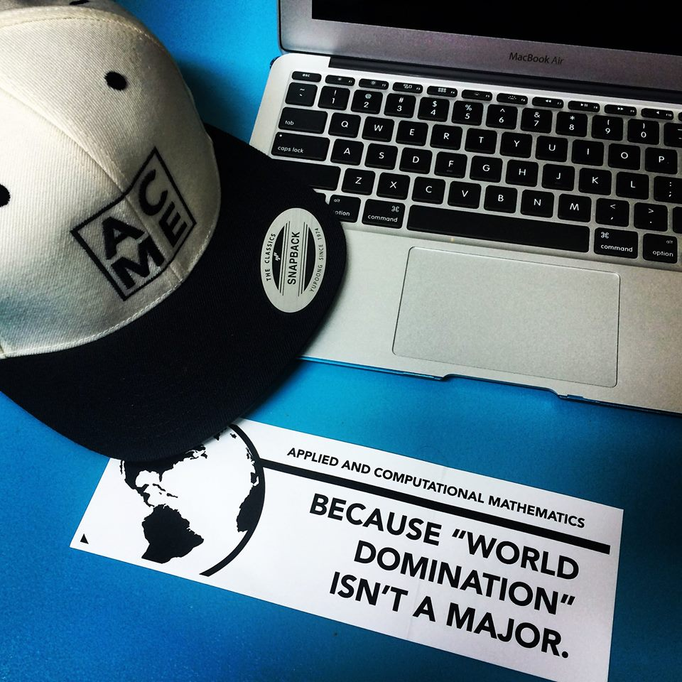
Pretty cool, huh?
Thoughts?
Did you find the error in the video?
Notes:
Apparently one of the equations is wrong on the video

Slide 9

Something tells me he would appreciate this
Notes:
He = the Brain (always trying to take over the world)
Source: http://img01.deviantart.net/b7c7/i/2015/115/1/e/my_drawing_of_pinky_and_the_brain_by_darcygagnon-d4w214i.jpg

Slide 10

ACME
Understanding and using math LITERALLY changes the world
You are learning how to change the world. Isn’t that incredible?

Slide 11

Example
How has the internet changed the world?
What innovation could you help trigger, that would change the world forever?
Notes:
Instructor:
Do any of you remember life before the internet?
What was it like?
The internet and its use have completely reshaped our world. You can be standing knee-deep in a lake in the Midwest, and pull out your phone to talk to your friend in Africa. You have access to more information than could possibly exist in the largest libraries in the world.
Yes, you’ve probably heard this before.
But, think of it!
What innovation could you help trigger, that would change the world forever?
With ACME, it is actually possible!
Read aloud (meant as more of an example than a discussion)
Image from pixabay.com

Slide 12
Group Activity
Break into groups of 2-3 and discuss the following questions:
Why did you choose ACME?
What is the most impressive thing you have ever seen done with math?
What is the most impressive thing you’ve done with math, yourself?
What do you want to be able to do when you graduate? In 10 years? 30?
Notes:
(4-6 minute activity)

Slide 13
ACME
Actually, world domination IS a major – and you’re in it
Yes, ACME is Applied and Computational Mathematics Emphasis, but it also means “the best, the peak, the summit, or the point of perfection.”
Notes:
Source: http://www.acme.byu.edu/?page_id=518

Slide 14
Yeah…but, how?
But…how? What makes ACME so amazing?
Let’s look into this
Notes:
Source: http://www.acme.byu.edu/?page_id=518

Slide 15
Why ACME?
“While educators, policy makers, and academics largely agree on the crucial role our STEM workforce plays in our nation’s health, universities struggle to attract and retain students in these fields. This shortfall is particularly pronounced in the mathematical sciences, where many academic departments have been slow to modernize their degree programs and prepare students for high-paying and personally enriching careers in mathematically- and computationally-intensive fields such as finance and economics, data science and predictive analytics, insurance and risk management, supply chain management, information security, national security, signal, image, and natural language processing, bioinformatics, and computational biology.”
Notes:
Read aloud
Source: BYU ACME Booklet, p. 7, paragraph 2

Slide 16

Not you
Your program has been specifically engineered to prepare students for high-paying and personally enriching careers in mathematically- and computationally-intensive fields
Awesome picture (?)
Notes:
Image from www.123rf.com

Slide 17


Examples
How can math “break” the game of baseball?
Notes:
Instructor: “Here are a few of those sorts of questions:”
Sources:
Flickr.com (Moneyball image)
en.wikipedia.org (Angels Stadium)

Slide 18

Examples
How can I use math to protect people from cyber fraud?
Notes:
Sources:
http://www.acme.byu.edu/wp-content/uploads/2015/04/How-my-bank-tracked-me-to-catch-a-thief-MarketWatch1.pdf
Image from www.creativerisksolutions.co.uk

Slide 19

Examples
How can math help me identify the products I might want to buy online?
Notes:
Image from en.wikipedia.org

Slide 20

Examples
How can math help paramedics make more accurate diagnoses in the field?
Notes:
See http://phys.org/news/2014-11-carbon-dioxide-algorithm-patients.html
Image from www.ada.com.au

Slide 21
Skills
ACME will help you develop real skills, which you might not have even heard of yet:
Algorithm design, analysis, and optimization
Statistical interpretation
Mathematical modeling (using the scientific method to solve real-world problems with math)
Data analytics
Complex problem-solving
IT skills
Mathematical writing + argumentation
Real-world application
Etc.

Slide 22

Answering questions
You’ll be able to answer questions like these:
“What is spectral theory?”
“How does scientificvisualization fit into the ACME world?”
“Describe Gram-Schmidt orthonormalization.”
Feeling smart yet?
Notes:
Questions taken from the coursework described in BYU ACME Booklet
Image from flickr.com

Slide 23



ACME + Companies
When you can answer these sorts of questions, companies will pay BIG money to have you.
Companies like:
Google
Microsoft
Amazon
Etc.
Notes:
Source: http://www.datasciencecentral.com/profiles/blogs/6000-companies-hiring-data-scientists
Images:
Images.google.com
Microsoft.com
Plus.google.com

Slide 24
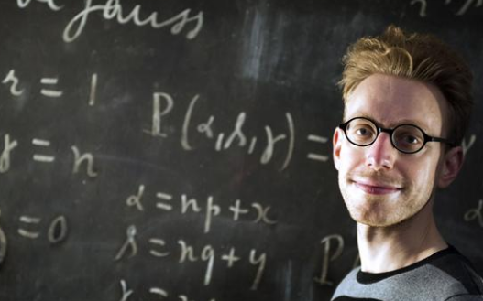
ACME + Companies 2
From 2014-2016, jobs that use applied math have come up #1 in the “Best jobs” lists published by the Wall Street Journal, US News, etc.
That’s a fantastic sign!
Notes:
Sources:
http://blogs.wsj.com/atwork/2014/04/15/best-jobs-of-2014-congratulations-mathematicians/
http://money.usnews.com/money/careers/slideshows/the-25-best-jobs-of-2015
http://www.careercast.com/jobs-rated/best-jobs-2016
Image from http://blogs.wsj.com/atwork/2014/04/15/best-jobs-of-2014-congratulations-mathematicians/

Slide 25
Activity – the future
Follow this link on your device (or share if you don’t have one with you)
http://goo.gl/JuvcW0
Quickly (2-3 minutes; you’re smart, right?) read the article with this question in mind:
How could applied math be used in these jobs?
Notes:
Source: http://www.fastcompany.com/3046277/the-new-rules-of-work/the-top-jobs-in-10-years-might-not-be-what-you-expect

Slide 26

Discussion
What are your findings? Can you use applied math in the future?
Take-away: Uh, duh. ACME is the PERFECT degree in preparing you for the future
Notes:
Image from http://digitalculture.club/futureisnow/

Slide 27
ACME Grads
Example 1: Tim Riser
Company: Innosight, a strategy and innovation consultancy founded by Clayton Christensen.
Position: Analyst
Job Description: Contribute to work on client engagements with Fortune 500 companies and leading NGOs on innovation and growth projects.
Advice: Prototype early and often.
Notes:
Other advice: If you're interested in consulting, that means going to Management Consulting Club meetings, going to information sessions, asking around for who would be a good person to set up a call and informal informational interview with, and reading Vault online reviews of different companies through BYU Library database access.
Every job is in an ecosystem. Don't perpetuate your ignorance. Get the lay of the land. Where are the most interesting jobs? What BYU connections can you find for those jobs on Linkedin? What clubs on BYU campus know people? What are the best online resources to find out more?
This is all simple exploratory research that you CAN DO. This is the easy stuff.
Do the research, and you'll know how to prepare, which is really the stuff that takes effort.

Slide 28
ACME Grads
Example 2: Orson Clay
Company: Wells Fargo Securities
Position: Investment Banking Analyst
Job Description: I [help] companies decide how best to structure themselves and from where they should get funding to support growth and other obligations.
Advice: Today is the day to start!
Notes:
More advice: By way of advice, what I have to say is that today is the day to start! Everyone will be telling you this, but just because that's annoying or it scares you doesn't mean it's not good advice and certainly doesn't mean it's not true. It took me over a year and a half, two internships, multiple personally funded networking and interviewing trips to New York, countless emails and hours on the phone, and personal research for me to get this job. Now, I may be an outlier, but still. Securing any job worth having is going to take work. Just because you are in ACME, does not mean that jobs will fall out of the sky (please do not censor this out). You, just like all other students and majors have to work for jobs. While BYU is a great school, it's not ivy league and we certainly deserve nothing. Just because you are a BYU student, does not mean that you are entitled to special treatment from anyone. However, because you are a BYU student, you are jumping into a network of people willing to help. It's been my experience that BYU alumni across all industries are very willing to help out and answer questions (myself included). We were all helped a lot to get where we are today. What you need to do to get started is get on the phone with people you think are interesting from your current and home wards, talk to BYU alumni that Lisa can arrange, talk to former ACME students, talk to anyone to find out what they do. During this, and every time you interact with a professional or upperclassmen you want to have the attitude of a learner. It will be very clear to whoever you are talking to that you are looking for a job, so don't ask for one. Just ask questions about their individual experience, what the job is like, how they got there, and any advice they have for you, etc. One last comment that I have is do not let school consume you. While it is important, grades and ACME are not the most important thing in your life (don't let Jeff take this out, please). School, ACME, grades - all come to an end. Eventually you will need to get a job. Whether or not you plan on grad school doesn't change that, it just postpones it. The more you can learn now the better. During my junior core fall semester of ACME I took a week off to fly to NYC. It was on that trip that I passed my resume along to the guy who got me the interviews that eventually led to me getting the job I now have. Be prepared to sacrifice for your future! It will always be worth it.
More Company description: I'm working for Wells Fargo Securities as an Investment Banking Analyst. For a brief background, Wells Fargo is one of the largest and most respected banks in the United States and the world. Wells Fargo Securities is one division within the larger Wells Fargo. Wells Fargo has three main divisions: the retail bank - that's where you open up a checking account, the commercial bank - where small to medium sized businesses have accounts and take out loans, and the wholesale bank - where large companies and corporations come for complex advice, funding, and support. Wells Fargo Securities sits within the Wholesale Bank of Wells Fargo and is its Investment Bank. Investment Banks provide complex advice and help to arrange funding for companies as they go through periods of transition, growth, or challenge. I will be working within the Corporate Finance group which focuses on Strategic Transaction and Capital Structure advisory. That's a lot of words to say, I will be helping companies decide how best to structure themselves and from where they should get funding to support growth and other obligations. Another part of my work will include understanding how to help companies work with tax rates, mergers and acquisitions (companies buying each other), divestitures (companies selling pieces off), spin- and split-offs (companies selling off a division to form a separate entity), and more.

Slide 29

Money?
Yes, you can make money “applying math” to the world’s problems.
Earnings for ACME graduates average around $65,000 starting, with 6-figure salaries in 10-12 years. (2016)
Other averages:
English: $45,000
Finance: $54,000
Chem. Engineering: $70,000
One control group of recent graduates is averaging over $80,000.
Pretty rad for an undergrad.
Notes:
Sources:
http://www.payscale.com/research/US/Degree=Bachelor_of_Arts_(BA),_English_Language/Salary
http://www.monster.com/career-advice/article/100k-jobs-by-college-major
Image from flickr.com

Slide 30

ACME
This is a great major, with incredible opportunity
Consider yourselves lucky, blessed, and quite smart to be here
Notes:
Image from www.pexels.com

Slide 31

So…what?
OK, so we’ve established that this is an incredible degree.
You are some of the brightest students in your university, possibly the nation – maybe the world
But, before you get a big head: Why are you in this class?
Notes:
Image from pixabay.com

Slide 32

Case study
In 2012, a bright, young student like yourselves asked PhysicsForums: Will applied math get me a job?
The response? What do you think?
Notes:
Source: https://www.physicsforums.com/threads/is-an-applied-mathematics-major-marketable-for-a-job.571599/
Image from pixabay.com

Slide 33
Case study
The response: IF YOU CAN NETWORK, you can get a job.
The respondent said further:
“Honestly, it's all about networking though. I'm sure if these guys were to really work at it, they'd be able to get jobs, but most of them aren't exactly great socialites. I think they just believed the whole guidance counselor thing that ‘if you go to college and do well, there will be jobs waiting for you.’”
Question: Do all ACME students struggle with networking?
Rhetorical question: Do you?
Notes:
Source: https://www.physicsforums.com/threads/is-an-applied-mathematics-major-marketable-for-a-job.571599/

Slide 34
Reality
So, ACME alone will get you:
A shiny degree
A huge amount of useful knowledge
Potentially, no money
If you can’t land the job and thrive in it, then your knowledge matters much less
Notes:
Image from fineartamerica.com

Slide 35

This course
This course exists to help you side-step that responder’s doom-and-gloom claim
This course is designed for:
Pragmatism (usefulness)
Practice in marketable skills
Preparing you for “the job”
Notes:
Image from commons.Wikimedia.org

Slide 36
This course – content
This course in two parts:
Semester 1: a crash course in job-getting skills, and ways to give you the edge once you have it
Semester 2: additional skills with specific benefits

Slide 37

Poll
So, what do you want to learn?
Notes:
Instructor: collect responses and give to designers for implementation in upcoming courses

Slide 38
Take-away
ACME is an incredible major, with limitless potential
With the right combination of hard and soft skills, you can wager your abilities for lots of success after college
This class is designed to give you the chance to develop soft skills that will allow you the chance to use your hard skills

Slide 39
For Next Class
Consider:
What kind of job do I want to prepare for?
How can I get there?

Slide 40
Assignment
Before next class, prepare a concise response to each of the following questions:
Tell me three things that you do well.
Tell me about a time when you were at your best. What did you do? Why were you at your best?
Why should I hire you? What makes you different from other applicants?
Notes:
Remind students that “concise” means specific, yet brief

Slide 41
Review
Objectives:
Display the importance of the ACME major and graduating students’ potential in earning, vocation, and success
Excite potential graduates about the potential possibilities of their expertise
Explore the need for a soft skills class in the ACME major

Slide 42
Additional resources
http://www.acme.byu.edu/
http://www.datasciencecentral.com/profiles/blogs/6000-companies-hiring-data-scientists
http://blogs.wsj.com/atwork/2014/04/15/best-jobs-of-2014-congratulations-mathematicians/
http://www.nbcnews.com/storyline/missing-jet/how-math-solved-mystery-missing-malaysian-jets-path-n62026
http://www.bloomberg.com/video/march-math-ness-breaking-down-the-brackets-3YExBDv1RG~KCvn81KDfWg.html
http://blogs.hbr.org/2014/02/recruit-better-data-analysts/

